Slide 1
Sarcasm Detector
(For Headlines)
Created by: Michael Dagher
ID#: 041088202

Slide 2
Dataset and Labels
News Headlines Dataset For Sarcasm Detection – Kaggle
Comes as a .json
Three attributes: is_sarcastic, headline, article_link
Is_sarcastic is the label, headline is the relevant text.

Slide 3
Overview of model structure
Unlike a tone classifier, sarcasm requires context.
Using an LSTM (Long Short-Term Memory layer) we can process data in order retaining past context.
Making it Bidirectional allows it to retain future context as well.

Slide 4
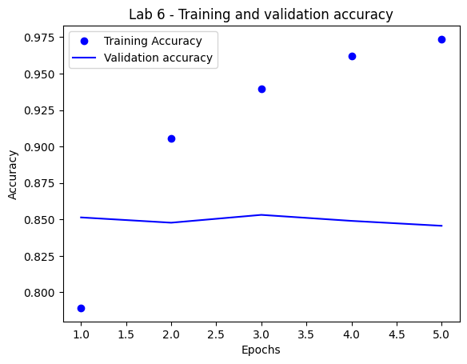
Model Performance
Training accuracy reached 97.36%
Validation accuracy hovered around 85%

Slide 5
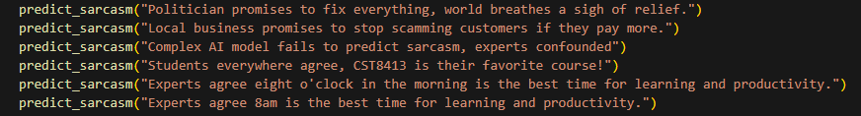
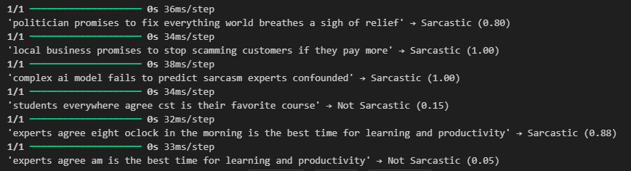
BEST PREDICTIONS

Slide 6
Potential Improvements
Spend more time fine-tuning the layers.
Adjust some of the parameters like the max sequence length (currently 20)
Re-factor to use TextVectorization instead Tokenizer

Slide 7
THANK YOU
Michael Dagher
ID#041088202

